Slide 1
Use of Force Data Collection
Presented by MSHP CJIS
Technical Training and Audit Section –
UCR & CJ Audit Program

Slide 2
What are the benefits?
Allows the agency data to guide the narrative
Allows for a clearer picture of Use of Force across the nation
Allows for uniform data to be collected on use of force
Required by RSMo 590.1265 - “Police Use of Force Transparency Act of 2021”
Notes:
Quote from Minnesota Justice Information Services “Our Superintendent’s take on the matter is that collecting the data allows us to drive the narrative rather than others with anecdotal information. In addition, he believes that it is better to be transparent so we can be proactive in identifying any potential issues or problems and take steps to make improvements. It also helps in showing the whole picture.”

Slide 3
HOW WAS IT DEVELOPED?
Approved by the CJIS Advisory Policy Board (APB) made up of our peers
Endorsed by International Association of Chiefs of Police (IACP) and the National Sheriff’s Association (NSA)
***Per the FBI, this data will not “allow for the final disposition or adjudication of a use of force incident”

Slide 4
Use of Force - Requirements
Police Use of Force Transparency Act of 2021
  590.1265. Citation of law — definitions — use-of-force incidents reporting, standards and procedures — publication of report data — analysis report. — 1. The provisions of this section shall be known and may be cited as the "Police Use of Force Transparency Act of 2021". Starting on March 1, 2022, and at least annually thereafter, each law enforcement agency shall collect and report local data on use-of-force incidents involving peace officers to the National Use of Force Data Collection
Requires reporting of qualifying Use of Force Incidents by all Law Enforcement agencies in Missouri
Notes:
DPS Policies and Standards set guidelines

Slide 5

Use of Force - Definitions
Per RSMo 590.1265
  "Law enforcement agency", defined in section RSMo 590.1040 as:
    Any public agency that employs law enforcement personnel Includes any Local, County and State Officers including Marshalls and Special Agents
  "Peace officer", defined in section 590.010 as:
    A law enforcement officer of the state or any political subdivision of the state with the power of arrest for violation of criminal code or declared or deemed a peace officer by state statute
Notes:
Federal not included

Slide 6
What Qualifies as an Incident?
Police Use of Force Transparency Act of 2021 - Reporting Requirements
  USE OF FORCE INCIDENT is defined as:
    A fatality occurs that is connected to a use of force by a peace officer:
    Serious bodily injury occurs that is connected to a use of force by a peace officer;
    In the absence of death or serious physical injury, a peace officer discharges a firearm at, or in the direction of a person(s)
Notes:
FBI is only looking at use of force with a firearm for third bullet

Slide 7
Use of Force Data
Who owns the data?
  The agency owns the data
    MSHP merely serves as a conduit
  The agency will be able to update data

Slide 8
How will this data be used/reported?
Per the FBI:
  No personally identifiable information is collected about those involved
  An agency wishing to not provide some information, such as officer characteristics may submit incomplete reports with some data as “pending” or “unknown.”

Slide 9
Use of Force – DPS REPORTING
  DPS will begin defining report types in late 2022 with an expected public release date of 2023
  For public consumption, all public queries for Missouri will be directed to the FBI’S Crime Data Explorer (CDE) website
Notes:
Refer to handout for details from slide 10
By March 1, 2023, and at least annually thereafter,
DPS shall publish the data reported by law enforcement
including statewide aggregate data and agency-specific data, in a publicly available report on DPS’s website
Such data shall be deemed a public record consistent with the provisions and exemptions contained in chapter 610.
DPS shall undertake an analysis of any trends and disparities in rates of use of force by all law enforcement agencies,
A report to be released to the public no later than June 30, 2025
The report shall be updated periodically thereafter, but not less than once every five years

Slide 10
Use of Force – FBI Publication
  The FBI plans on using statistical tables along with:
      Emphasis on visual data representation
      Caveats about the use of data
      And methodology of gathering data
  The FBI will have three levels of data
      State level
      Region level
      National level
  Nothing will be published at the agency level

Slide 11
Use of Force – FBI Publication
The FBI is already publishing UoF data that it has on file
  Consisting of contributing agencies until 60% threshold is met
Will be published on the FBI’S Crime Data Explorer (CDE)
  The CDE may be updated quarterly

Slide 12
Use of Force – CDE
  DATA published on FBI’S CDE after reaching 60% participation
      % type of UoF incident
      % type of initial contact
      Top five types of resistance
      Top five types of force used
  Again, data will not be tied to an agency
  At 80% participation they will start releasing more information to include number of types at each level (state, region, national) but NOT agency

Slide 13
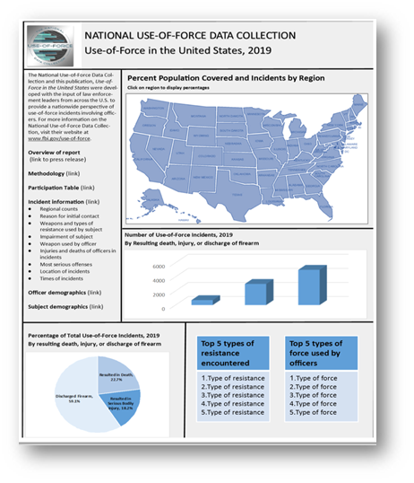
Use of Force
FBI Crime Data Explorer

Slide 14
Registration process

Slide 15
How to Get Access
Who will submit for your agency?
Agency UoF Point of Contact (POC)
    Agency will choose someone at the agency to submit UoF
    Can be the MIBRS POC or someone different
    This person will need to register for a UoF access
Utilize UCR User Access Request Form

Slide 16
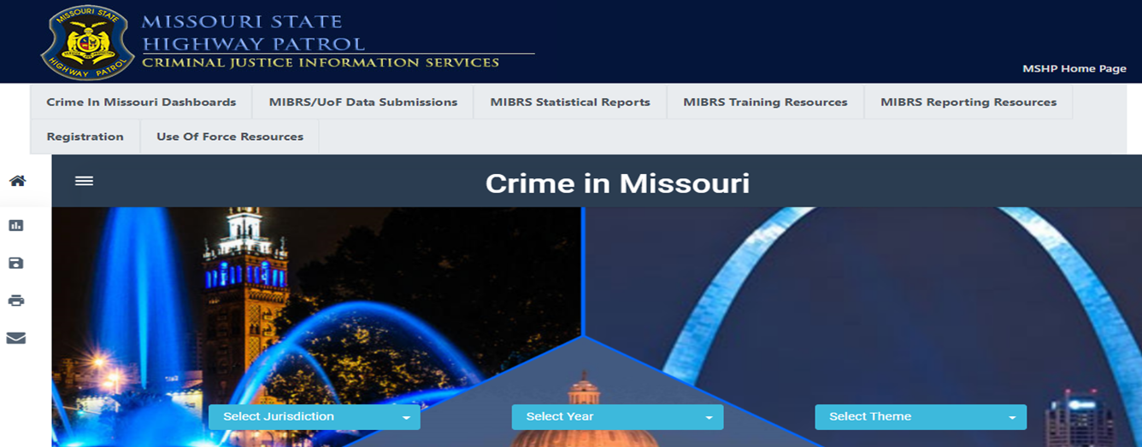
Use of Force - Registration
Registration can be accessed through the MSHP’s Show Me Crime web page
  MIBRS dashboard page

Slide 17
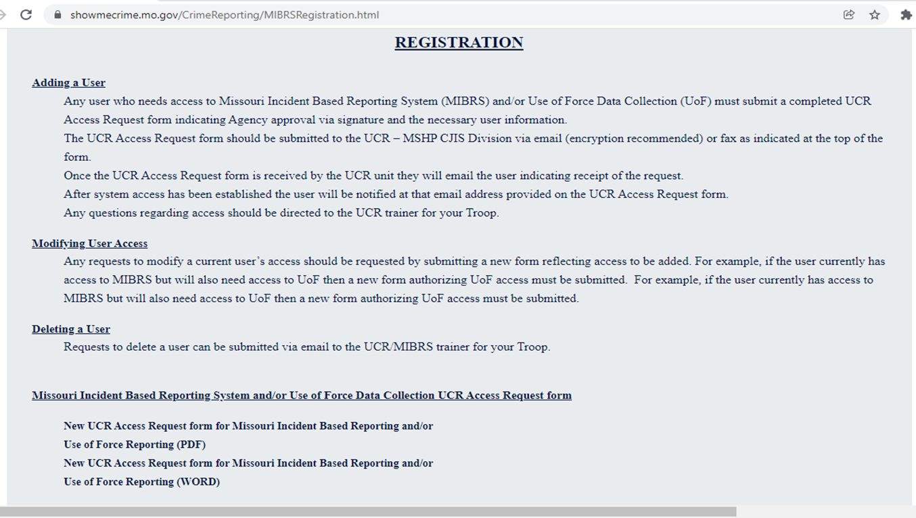
Use of Force – Registration

Slide 18
Use of Force – User Access Request Form
Complete the UCR User Access Request Form (SHP 146)
Be sure to designate the type of access
  Can be UoF Only, UoF and MIBRS or MIBRS only
Agency Head signature required
  Verified, may need to submit updated SHP-130
Fax number and email address at top of form
  Can be submitted by fax, electronic fax or email
  If by email, the email should be encrypted

Slide 19
Use of Force – Registration
Once User Access form is submitted
  The UCR Unit will email the user indicating receipt of request
  Once access is granted, the user will be notified at the email address provided on the SHP 146
To modify an existing user, submit a new User Access Request form
To delete a user, submit a delete request to your local MIBRS Trainer
Any questions, please contact your local MIBRS Trainer

Slide 20
When do Submissions begin?
  Starting on March 1, 2022
  MSHP has an entry portal available on Show Me Crime webpage (www.showmecrime.mo.gov) which will be demonstrated later
  Failure to comply
    Non-compliance will be handled by DPS in accordance with statutory requirements

Slide 21
SUBMISSION REQUIREMENTS
  Completed by the 10th of the following month
      So that data can be transmitted to the FBI on the 15th
  Even if nothing to report, a zero report will be submitted for each month
  The Use of Force report does not take the place of any federal or state death in custody reports
      Those still need to be submitted separately

Slide 22
Let’s Break Down the Details
What do I need to know to make a Use of Force entry?

Slide 23
Do you have a qualifying incident?
What is considered a User of Force Incident:
  A fatality occurs that is connected to a Use of Force by a peace officer
  Serious bodily injury occurs that is connected to a Use of Force by a peace officer
  In the absence of death or serious physical injury, a peace officer discharges a firearm at, or in the direction of, a person(s)

Slide 24
USE OF FORCE - DEFINITIONS
What is considered “Serious Bodily Injury”?
  RSMo 590.1265 refers to RSMo 556.061 to define “SERIOUS BODILY INJURY” as:
    “physical injury that creates a substantial risk of death or that causes serious disfigurement or protracted loss or impairment of the function of any part of the body;”
  The FBI uses Title 18 United States Code (U.S.C.) section 2246 (4) to define it as:
    bodily injury that involves a substantial risk of death, unconsciousness, extreme physical pain, protracted and obvious disfigurement, or protracted loss or impairment of the function of a bodily member, organ, or mental faculty;

Slide 25
Use of Force - Definitions
Serious bodily injury would include:
    all gunshot wounds (regardless of whether they are penetrating or grazing)
    apparent broken bones
    possible internal injury, severe laceration, stitches, sutures
    chipped teeth, loss of teeth
    canine bites requiring medical attention
    unconsciousness due to an applied carotid artery hold
    injuries severe enough to require medical intervention and/or hospitalization
The term "medical intervention" does not include routine evaluation of the subject to determine fitness for arrest or detention by an emergency medical technician or medical staff at a medical facility
Notes:
For example: serious bodily injury could result from use of asp or baton

Slide 26
Use of Force - Definitions
Firearm is defined by Title 18 U.S.C. 921 (A)(3):
  any weapon (including a starter gun) which will or is designed to or may readily be converted to expel a projectile by the action of an explosive;
  the frame or receiver of any such weapon;
  any firearm muffler or firearm silencer; or
  any destructive device
Firearms discharged at or in the direction of a person(s) with less lethal munitions, such as beanbags, pepper balls, and rubber bullets are excluded
In addition, electronic control weapons are not to be considered firearms. (Ex: Tasers/Stun Gun etc.)

Slide 27
Now that I know I have an incident what do I do?

Slide 28
Use of Force - Submissions
Data Submission - Two options
    RMS generated FBI compliant UoF file through Show Me Crime webpage via Crime Insight upload page
    Manual data entry through Show Me Crime webpage via Crime Insight web entry
Either one is acceptable
Notes:
No CHARGE

Slide 29
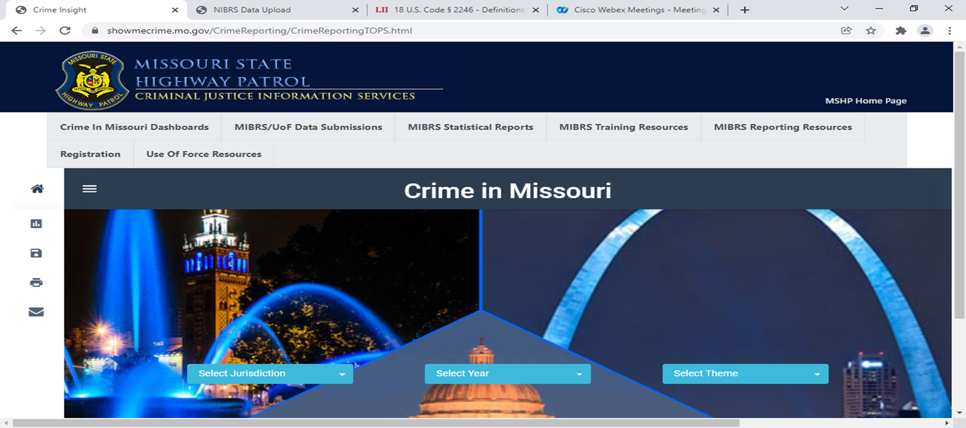
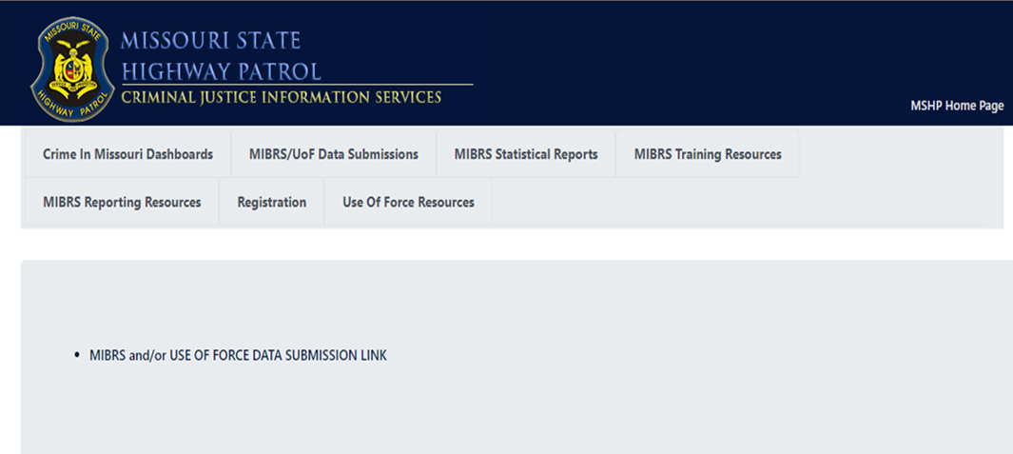
Use of Force
Accessing UoF Submission Page
Click Here
Then Here

Slide 30
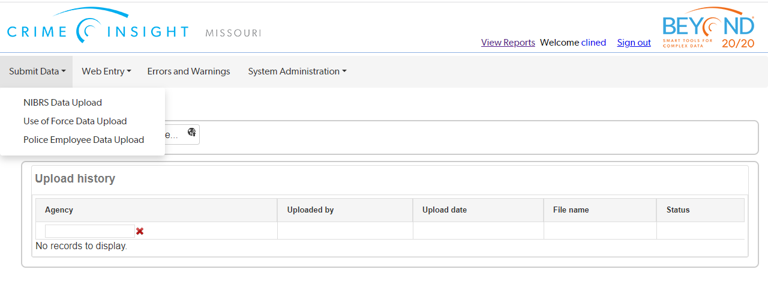
Use of Force – Uploading Data

Slide 31
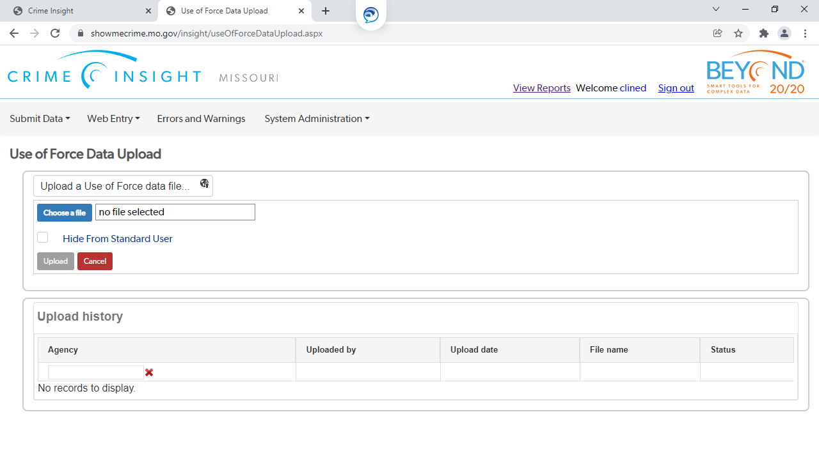
Use of Force – Uploading Data

Slide 32
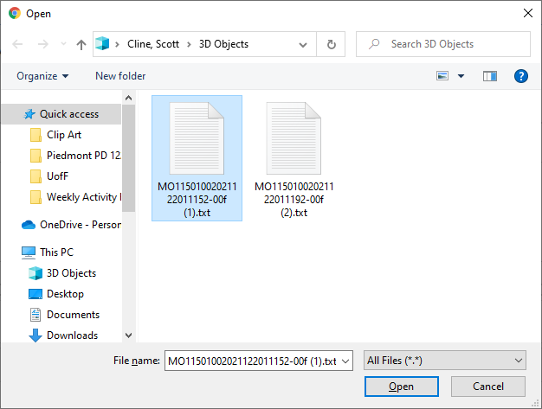
Use of Force – Uploading Data
Submitting from RMS generated file
  Find the file and then click “OPEN”

Slide 33
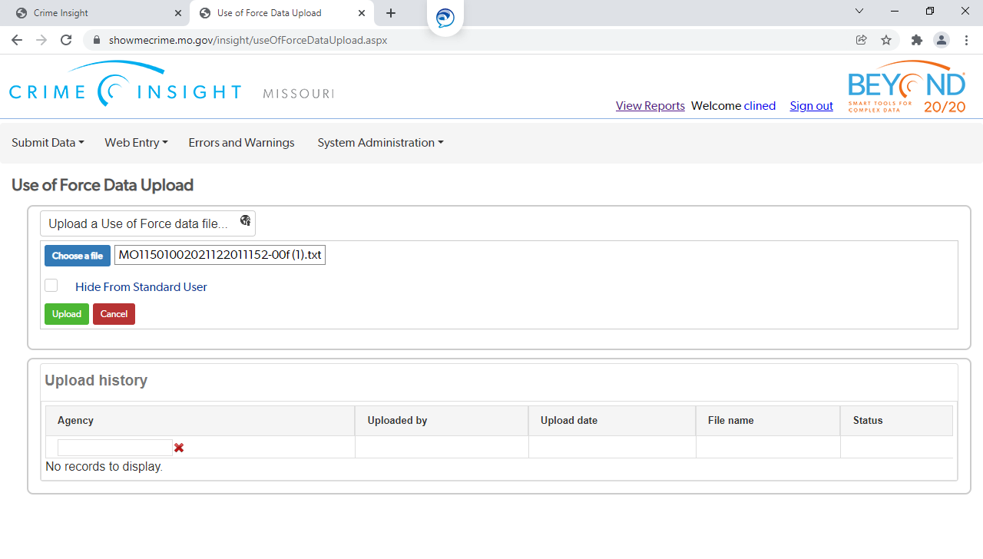
Use of Force – Uploading Data
Submitting from RMS generated file
  Once file name appears in file box, select “UPLOAD”

Slide 34
Use of Force – Uploading Data
Submitting from RMS generated file
File will upload and be validated for errors or warnings
If errors, correct and resubmit the incident(s)
If warnings, review the warned data to ensure that it is accurate
  If not accurate, correct and resubmit
  If accurate, notify your MIBRS Trainer to remove the warning

Slide 35
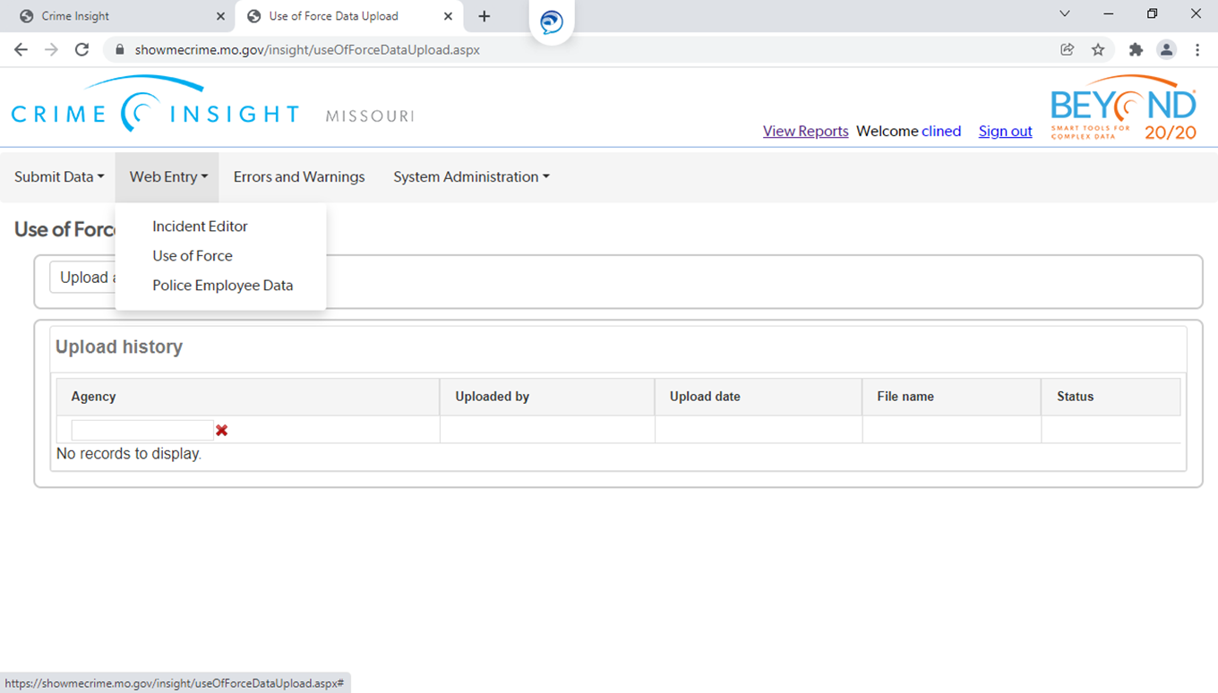
Use of Force - Entry
Submitting through the direct entry portal
Access the entry portal following the same log in steps

Slide 36
Use of force
Submission demo
  Will cover all information (data elements) required
  For the demo, please refer to:
    Use of Force outline handout
      Additional technical resources are available on the Use of Force Resource tab on the Show Me Crime webpage

Slide 37
Use of Force - Demo
Any questions before we begin?
You can always reach out to MIBRS Trainers, contact info in handout

